Slide 1
Building Multi-Tenant Applications

Slide 2
Agenda
Who am I
What is multi-tenancy
How to detect a tenant
Demo time!

Slide 3
Who am I?

Slide 4
Ruben
Started on KdG
7 Jaar dotnet
Full stack developer
Architect
Trainingen
Sessies
Internship
….
🥁 🎸 🎹
🎲 🐉

Slide 5
What is multi tenancy?

Slide 6
What is it?
Running your software for multiple clients (aka tenants) at once

Slide 7
Not all Multi-tenancy is equal
What do you think is possible?

Slide 8
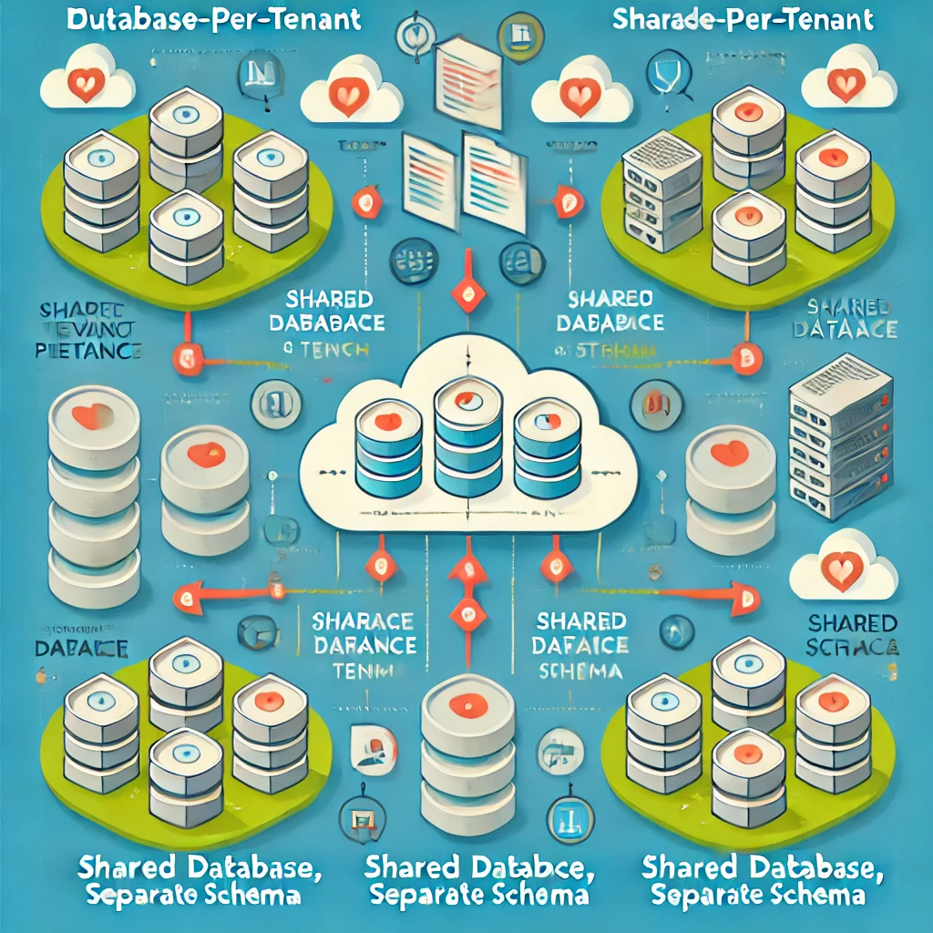

Slide 9
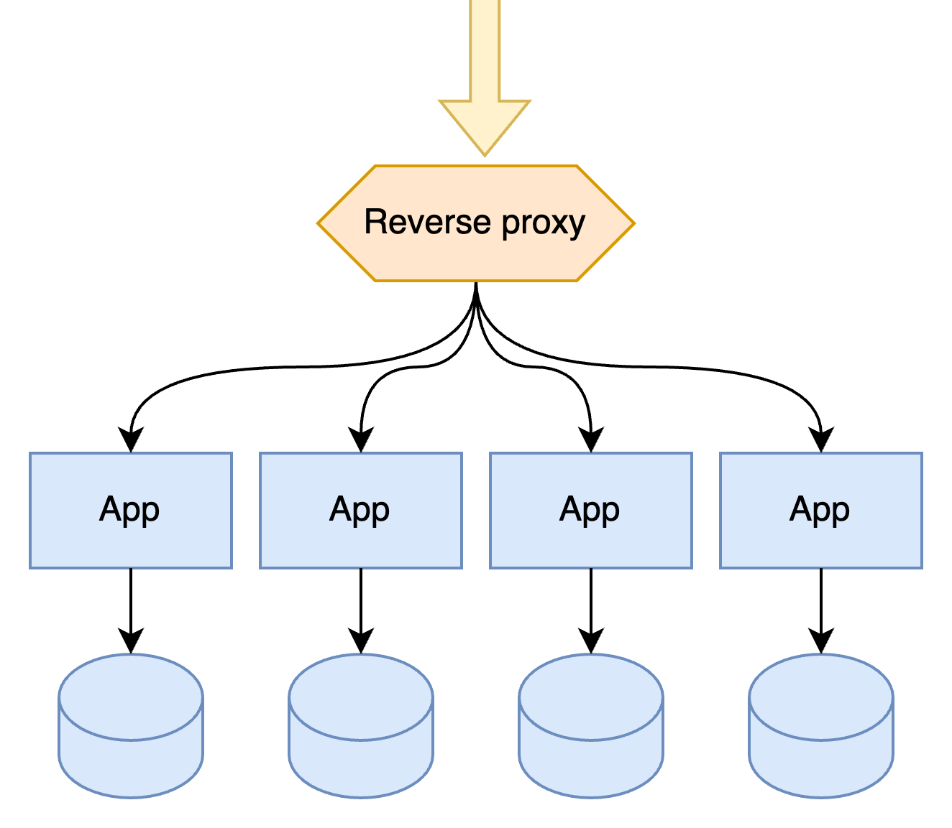

Slide 10
Multi-tenancy by infrastructure
✅ App has no knowledge of tenants
✅ Data is perfectly separated
❌ Cross-cutting concerns are harder
❌ High cost of operation
❌ Cross tenant reporting

Slide 11
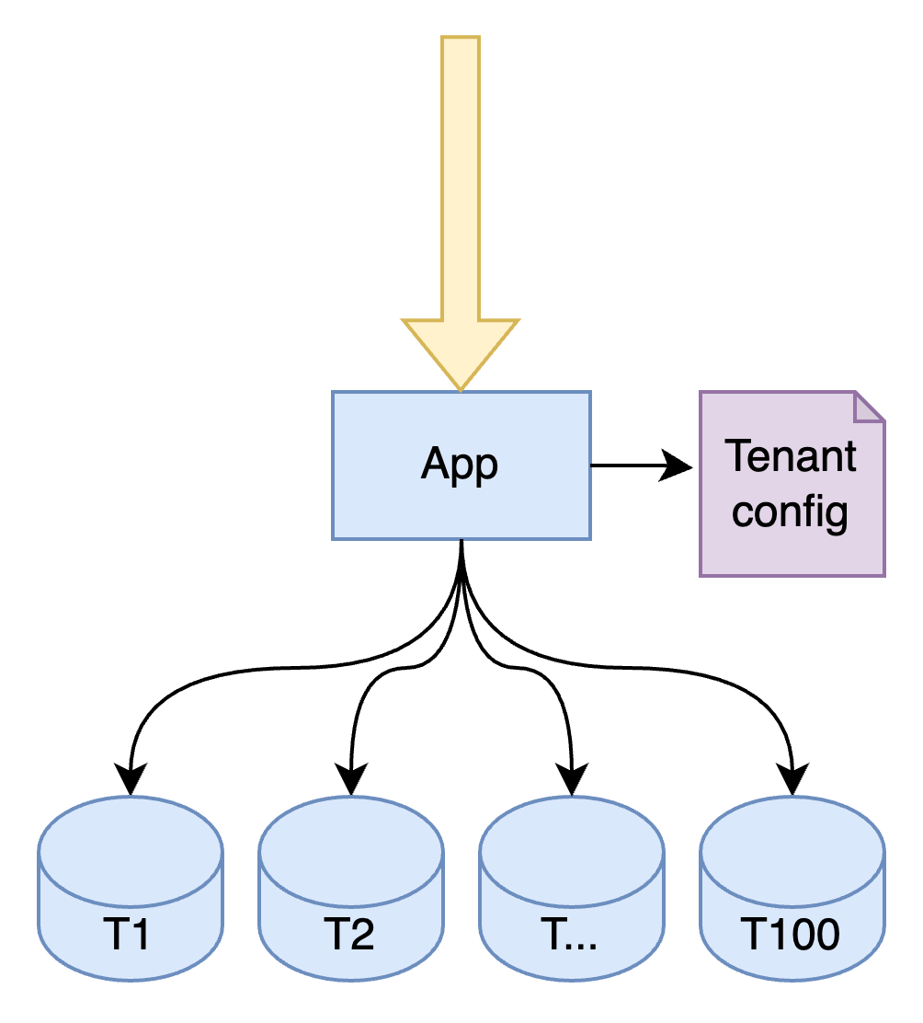

Slide 12
Database per tenant
✅ Data is perfectly separated
💭 App needs config per tenant
❌ (still) high cost of operation
❌ Data consistency between tenants
❌ Cross tenant reporting

Slide 13
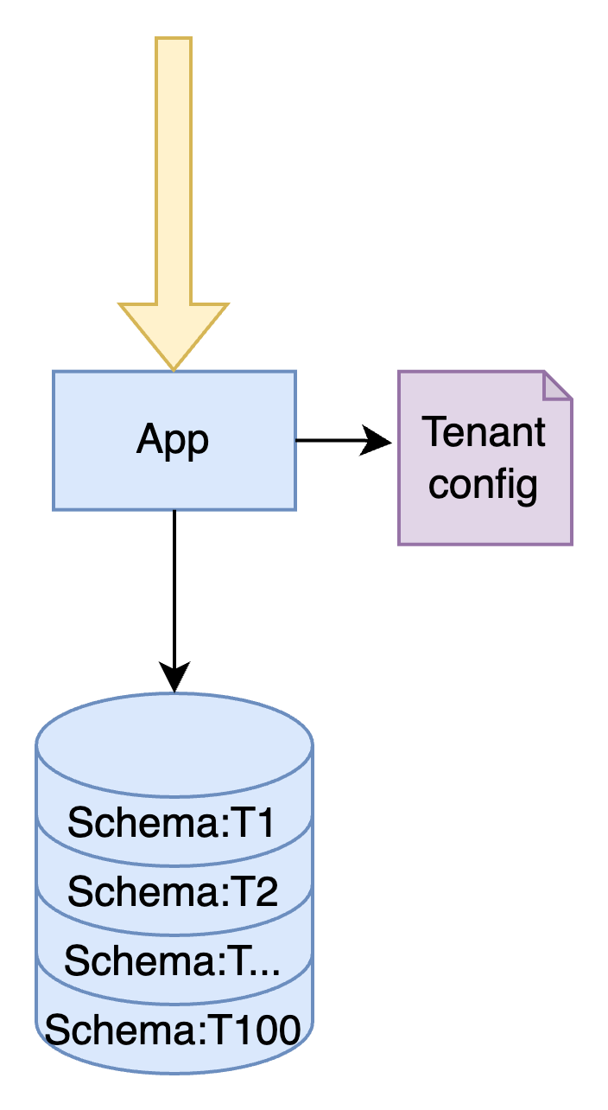

Slide 14
Schema per tenant
✅ Data is mostly separate
✅ Lower operation cost
✅ Cross-tenant reporting is possible
💭 App needs config per tenant
❌ Noisy neighbors

Slide 15
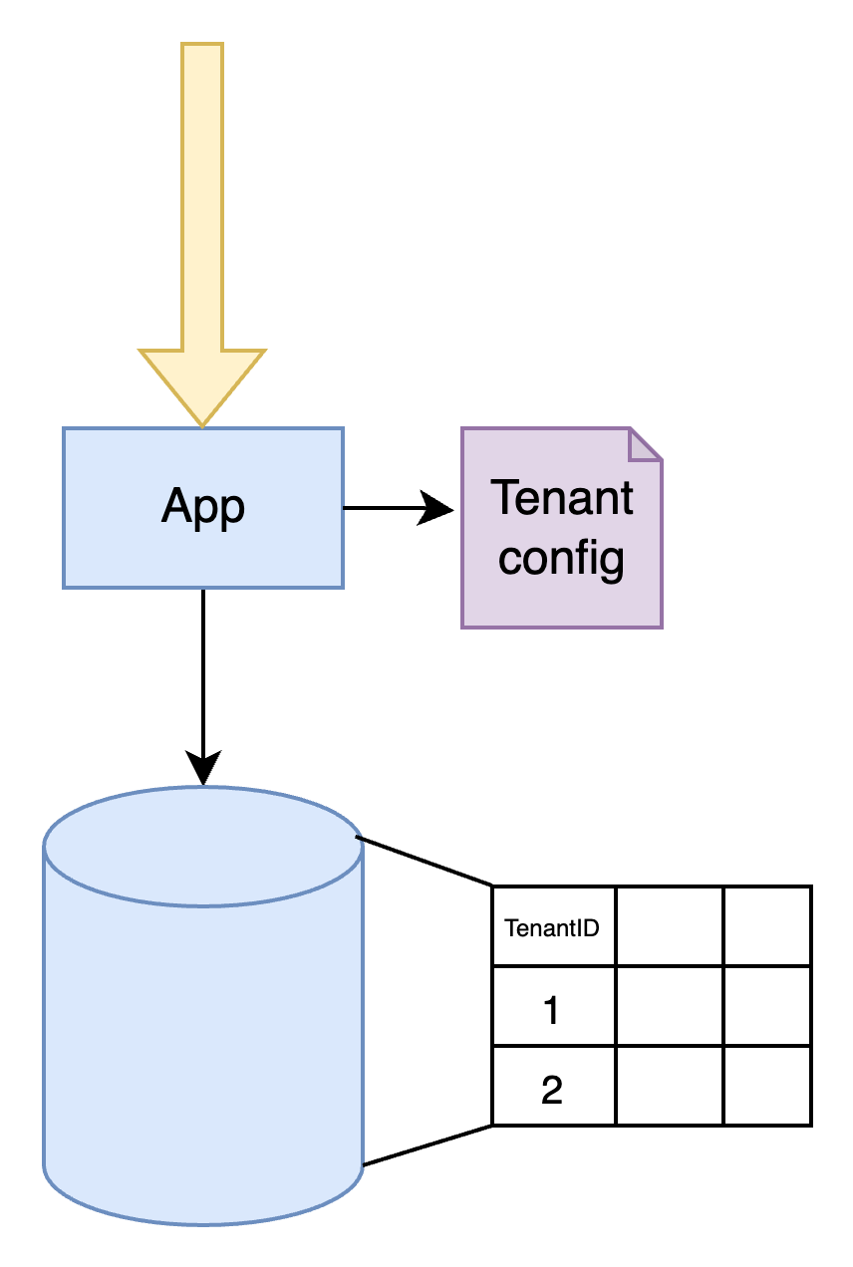

Slide 16
Discriminator column
✅ Lower operation cost
✅ Cross-tenant reporting is possible
✅ Easy to set up
✅ Easy to understand
💭 App needs config per tenant
❌ Noisy neighbors
⚠️ Risk leaky tenant data

Slide 18
Best one?

Slide 19
It depends
🤷

Slide 20
Who’s knocking at the door?
How do you know which tenant to serve

Slide 21
What in what ways could we detect which tenant is calling ?

Slide 22
Query string
https://my-website.com?tenantId=customer1

Slide 23
Header
GET http://my-website.com/page x-TenantId: customer1

Slide 24
Subdomain
http://customer1.my-website.com/page

Slide 25
Enough Talk Show me the code 🧑‍💻
What tenant is calling

Slide 26
Demo time!
Let’s make an application multi-tenant aware!

Slide 27
Script
Detect a tenant
Middleware
Subdomain
TenantContext + Accessor
Reflect a tenant
Knowing available tenants ->
TenantConfig extending with custom info
Protect a tenant
ApplicationUser
ApplicationUserStore
MultiTenantSigninManager
Protect the data
Introduce Itenant
QueryFilter

Slide 28
Detecting a tenant

Slide 29
Detecting a tenant – Tenant.cs
public class Tenant { public string Id { get; set; } }
public class TenantContextAccessor { public Tenant Tenant { get; set; } }

Slide 30
Detecting a tenant - TenantDependencyExtensions
public static class TenantContextAccessorExtensions { public static IServiceCollection AddTenantContext(this IServiceCollection services) { services.AddScoped<TenantContextAccessor>(); services.AddTransient<Tenant>(p => p.GetRequiredService<TenantContextAccessor>().Tenant ?? new Tenant() ); return services; } }

Slide 31
Reflecting a Tenant

Slide 32
Reflecting a tenant – Tenant.cs
public class Tenant { public string Id { get; set; } public string Name { get; set; } public string BackgroundColor { get; set; } public string BackgroundImage { get; set; } }

Slide 33
Reflecting a tenant – appsettings.json
"AvailableTenants": { "Tenants": [ { "Id": "pallet-town", "Name": "Pallet Town", "BackgroundColor": "#75d9d7", "BackgroundImage": "https://archives.bulbagarden.net/media/upload/7/77/Pallet_Town_FRLG.png" }, { "Id": "vermillion-city", "Name": "Vermillion City", "BackgroundColor": "#b956ff ", "BackgroundImage": "https://archives.bulbagarden.net/media/upload/8/8d/Vermilion_City_FRLG.png" } ] }
Notes:
#75d9d7
https://archives.bulbagarden.net/media/upload/7/77/Pallet_Town_FRLG.png
#b956ff https://archives.bulbagarden.net/media/upload/8/8d/Vermilion_City_FRLG.png

Slide 34
Reflecting a tenant – program.cs
builder.Services.Configure<AvailableTenants>( builder.Configuration.GetSection(AvailableTenants.SectionName) );
OR
public class AvailableTenantsSetup(IConfiguration configuration) : IConfigureOptions<AvailableTenants> { public void Configure(AvailableTenants options) { configuration.GetSection(AvailableTenants.SectionName).Bind(options); } }

Slide 35
Reflecting a tenant – Tenant.cs
public class AvailableTenantsSetup(IConfiguration configuration) : IConfigureOptions<AvailableTenants> { public void Configure(AvailableTenants options) { configuration.GetSection(AvailableTenants.SectionName).Bind(options); } }
public static class TenantExtensions { public static IServiceCollection AddTenantContext(this IServiceCollection services) { services.AddScoped<TenantContext>(); services.AddTransient<Tenant>(p => p.GetRequiredService<TenantContext>().Tenant); services.AddSingleton<IConfigureOptions<AvailableTenants>, AvailableTenantsSetup>(); return services; } }

Slide 36
Reflecting a tenant – Index.cshtml
@page @using Pokedex.Framework @model PokeCenter.web.Pages.IndexModel @inject Tenant tenant; @{ ViewData["Title"] = "Home page"; } <div class="text-center"> <h1 class="display-4">Welcome at @tenant.Name</h1> <img src="@tenant.BackgroundImage"/> </div>

Slide 37
Reflecting a tenant – _Layout.cshtml
<nav class="navbar navbar-expand-sm navbar-toggleable-sm navbar-light border-bottom box-shadow mb-3" style="background-color: @tenant.BackgroundColor;" >
…
</nav>

Slide 38
Protecting a Tenant

Slide 39
Protecting a tenant – ApplicationUser.cs
public class ApplicationUser : IdentityUser { public string TenantId { get; set; } }

Slide 40
Protecting a tenant – ApplicationDbContext.cs
public class ApplicationDbContext( DbContextOptions<ApplicationDbContext> options) : IdentityDbContext<ApplicationUser>(options) { //… }

Slide 41
Protecting a tenant – Add Migration
dotnet ef migrations add applicationuser -s ../PokeCenter.web

Slide 42
Protecting a tenant – ApplicationUserStore
public class ApplicationUserStore( ApplicationDbContext context, Tenant tenant, IdentityErrorDescriber? describer = null) : UserStore<ApplicationUser>(context, describer) { public override Task<IdentityResult> CreateAsync(ApplicationUser user, CancellationToken cancellationToken = new CancellationToken()) { user.TenantId = tenant.Id; return base.CreateAsync(user, cancellationToken); } }

Slide 43
Protecting a tenant – MultiTenantSigninManager
public class MultiTenantSigninManager( /**/, Tenant tenant ) : SignInManager<ApplicationUser>(/**/) { public override Task<SignInResult> PasswordSignInAsync(ApplicationUser user, string password, bool isPersistent, bool lockoutOnFailure) { if (user.TenantId != tenant.Id) return Task.FromResult(SignInResult.Failed); return base.PasswordSignInAsync(user, password, isPersistent, lockoutOnFailure); } };

Slide 44
Protecting a tenant – Program.cs
builder.Services .AddDefaultIdentity<ApplicationUser>(options => options.SignIn.RequireConfirmedAccount = true) .AddEntityFrameworkStores<ApplicationDbContext>() .AddUserStore<ApplicationUserStore>() .AddSignInManager<MultiTenantSigninManager>() ;

Slide 45
Protecting a tenant – LoginPartial.cshtml
@* @inject SignInManager<ApplicationUser> SignInManager *@ @inject MultiTenantSigninManager SignInManager @inject UserManager<ApplicationUser> UserManager

Slide 46
Protecting the data
(of a tenant)

Slide 47
Protecting the data – Itenanted.cs
public interface ITenanted { public string TenantId { get; set; } }

Slide 48
Protecting the data – HealingPod.cs
public class HealingPod : ITenanted { public int Id { get; set; } public int MaxCapacity { get; set; } public List<PokemonAdmission> Admission { get; set; } public string TenantId { get; set; } }

Slide 49
Protecting the data – PokemonAdmission
public class PokemonAdmission : ITenanted { public int Id { get; set; } //…
public string TenantId { get; set; } }

Slide 50
Protecting the data – TenantIdValueGenerator
public class TenantIdValueGenerator : ValueGenerator<string> { public override string Next(EntityEntry entry) { if (entry.Entity is ITenanted && entry.Context is ApplicationDbContext applicationDbContext) { return applicationDbContext.Tenant; } throw new InvalidOperationException("TenantId is expected to be set on this entity!"); } public override bool GeneratesTemporaryValues { get; } = false; }

Slide 51
Protecting the data – HealingPodEntityTypeConfiguration
public class HealingPodEntityTypeConfiguration : IEntityTypeConfiguration<HealingPod> { public void Configure(EntityTypeBuilder<HealingPod> builder) { builder.HasKey(e => new { e.Id }); builder.Property(e => e.TenantId).IsRequired(); builder.HasIndex(e => e.TenantId); builder.Property(e => e.TenantId).HasValueGenerator<TenantIdValueGenerator>(); } }

Slide 52
Protecting the data – PokemonAdmissionEntityTypeConfiguration
public class PokemonAdmissionEntityTypeConfiguration : IEntityTypeConfiguration<PokemonAdmission> { public void Configure(EntityTypeBuilder<PokemonAdmission> builder) { builder.HasKey(e => new { e.Id }); builder.Property(e => e.TenantId).IsRequired(); builder.HasIndex(e => e.TenantId); builder.Property(e => e.TenantId).HasValueGenerator<TenantIdValueGenerator>(); } }

Slide 53
Keeping it DRY
(with magic 🪄)

Slide 54
Keeping it DRY (with magic 🪄)
protected override void OnModelCreating(ModelBuilder builder) { var tenantedModels = builder.Model.GetEntityTypes() .Where(e => typeof(ITenanted).IsAssignableFrom(e.ClrType)); foreach (var tenantedModel in tenantedModels) { builder.Entity(tenantedModel.ClrType) .HasQueryFilter<ITenanted>(e => e.TenantId == Tenant) .HasIndex(nameof(ITenanted.TenantId)) ; builder.Entity(tenantedModel.ClrType) .Property(nameof(ITenanted.TenantId)) .IsRequired() .HasValueGenerator<TenantIdValueGenerator>(); } builder.ApplyConfigurationsFromAssembly(typeof(ApplicationDbContext).Assembly); base.OnModelCreating(builder); }

Slide 55
Keeping it DRY (with magic 🪄)
public static class QueryFilterExtensions { public static EntityTypeBuilder HasQueryFilter<T>(this EntityTypeBuilder entityTypeBuilder, Expression<Func<T, bool>> filterExpression) { var param = Expression.Parameter(entityTypeBuilder.Metadata.ClrType); var body = ReplacingExpressionVisitor.Replace(filterExpression.Parameters.Single(), param, filterExpression.Body); var lambdaExp = Expression.Lambda(body, param); return entityTypeBuilder.HasQueryFilter(lambdaExp); } }

Slide 56
Where to find stuff
Code on github
https://github.com/RubMertens/presentation-multi-tenant-apps

